Slide 1



Python-Compiler
Python to X86-64
Presented By:
Team 8, Fire-Coders

Slide 2



Introduction
Our compiler, can run a python code with all the necessary features supported, plus some additional ones.
It can generate symbol table for corresponding functions and classes.
It generates 3AC and the corresponding X86 code.

Slide 3


Milestones

Slide 4
Milestone - 1
1
Made a lexer using the python specifications
2
Implemented python grammar 3.7 using Bison
3
Made an AST representation for the given python program
4
Implemented optional flags including --help, --input, --output and --verbose
5
Nodes carry information like line number, lexical category etc.

Slide 5
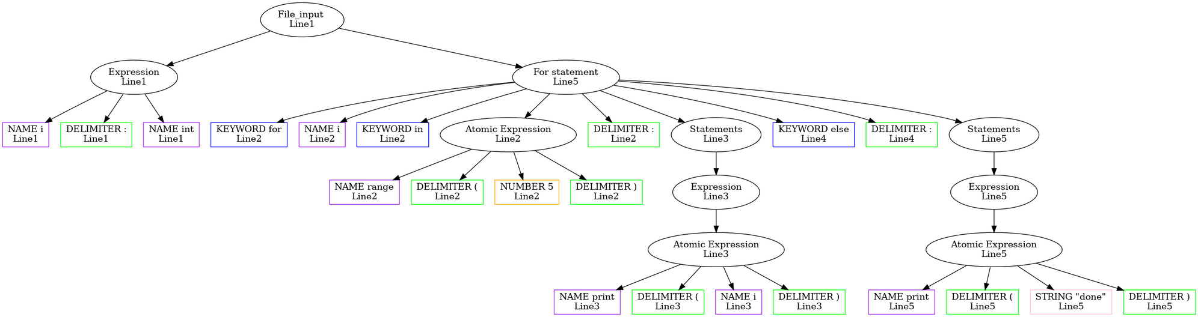
An example AST

Slide 6
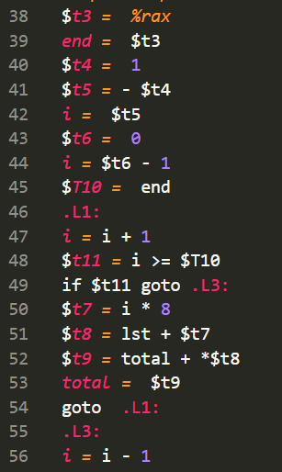
Milestone - 2
Hierarchical symbol table for classes, functions and global symbol table
1
2
Type checking using the symbol table information
3
Relevant type errors thrown wherever required
4
3AC generated while parsing the input
3AC instructions for manipulating stacks such as pushing rbp before functional call and adding space for local variables in the stack
5
6
Function arguments also pushed and popped using stack

Slide 7
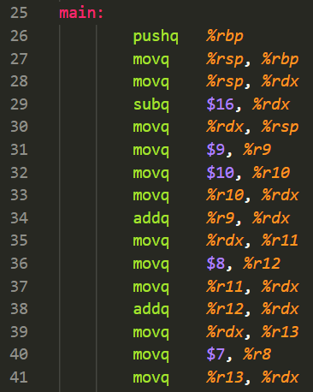
Milestone - 3
Generated the x86 assembly code for the python code given
1
Used the simple pattern matching based approach for
code generation
2
Used registers for storing temporaries based on simple
def and use based heuristic
3
Added support for strcmp, print, malloc, len and range in
the 3AC
4

Slide 8
Additional Features
Function calls can be given as arguments to another Function. For e.g. print(len(array))
1
6 registers (%r8 to %r13) are used for storing temporaries. When the registers are not sufficient, stack allocation of temporary values starts.
2
Local Instruction rescheduling at the scope of an expression or statement is performed so that registers are used in an efficient manner
3
4
Function calls are allowed inside lists. For e.g. arr: list[int] = [1, square(5), 4]
5
L-value checking is supported
6
Implicit line joining is also supported

Slide 9
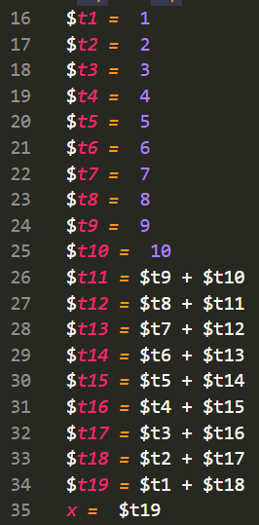
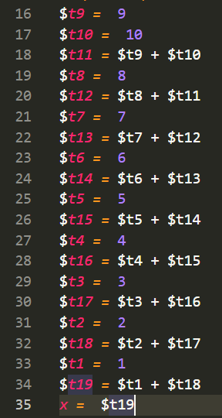
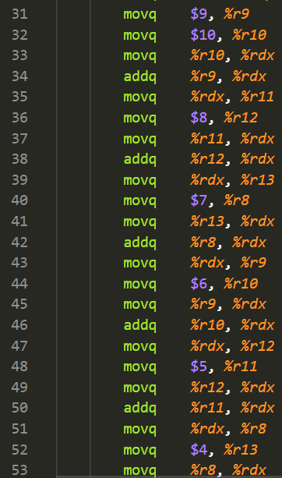

Instruction Rescheduling and Register Allocation
Instruction
Rescheduling
Register
Allocation

Slide 10


Demonstration

Slide 11



Slide 12
Effort Sheet
Aditya kumar
33.33%
210060
Geetika
33.33%
210392
Antriksh Gupta
33.33%
210159

Slide 13
Thank You

